Slide 1

REVENUE REPORT
HEALTHCARE FACILITIES
growth
follow
patient Info
services
teams
about
DESIGNED BY GROUP 4
Miss. Varshasree Pasupuleti
Miss. Rutuja Mahadeorao Lokhande
Mr. Abhijeet Satyavan Tekawade
Mr. Mahesh Sahu
Mr. Laxman Kunwar
Mr. Abhishek Juyal

Slide 2




Revenue Report Highlights
Total Discharge: Total discharge refers to the number of patients who have been discharged from a healthcare facility within a specified time period.
Patient Days: Patient days represent the total number of days that patients have spent in a healthcare facility during a specific period.
Net Patient Revenue: Net patient revenue is the total revenue generated from patient services after deducting contractual allowances, discounts, and adjustments. It reflects the financial performance of a healthcare organization and its ability to generate revenue from patient care activities.
Type of Hospital Revenue: This parameter focuses on analysing the revenue generated by different types of hospitals, such as public, private, specialty, or teaching hospitals. Understanding the revenue patterns based on the type of hospital helps in assessing market dynamics, evaluating the financial viability of different healthcare models, and making strategic decisions.
These parameters provide valuable insights into the financial and operational aspects of healthcare organizations, facilitating effective decision-making and the implementation of strategies to enhance revenue generation and patient care.
growth
patient Info
follow
teams
services
about
During this project we worked in different phases & tools. Finally to present the in depth analysis for each KPI in the form of an interactive dashboard we used,
MS-Excel
MySQL
Power BI
tableau

Slide 3





Revenue Growth by Year and Quarter
2016
2017
2018
2019
2020
1
4
4
4
2
Quarter
Quarter
Quarter
Quarter
Quarter
follow
patient Info
growth
services
teams
about
The revenue for Qtr 3 has shown a consistent upward trend since 2017, with a remarkable increase of 13.69% or 3.93 billion over the course of two years.

Slide 4
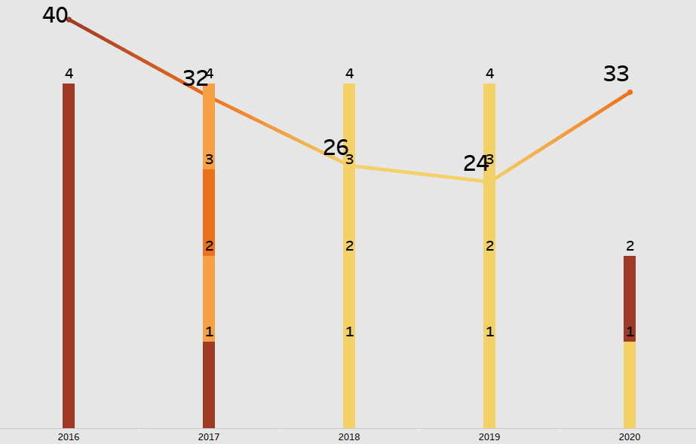

At 40, 2016 had the highest Average days of Patient stay and was 65.43% higher than 2019.
2019, had the lowest Average days of Patient stay at 24.
Superior Healthcare is exemplified by the Average Patient stay spanning from 24 to 40 days over the course of 5 Year.
Average days of Patient stay is 29.
growth
follow
patient Info
services
teams
about
Outpatient revenue 39.83%
474 bn
Between 2016-2020, hospital Inpatient Revenue grew at 20.34% higher than Outpatient Revenue.
Inpatient revenue 60.17%

Slide 5
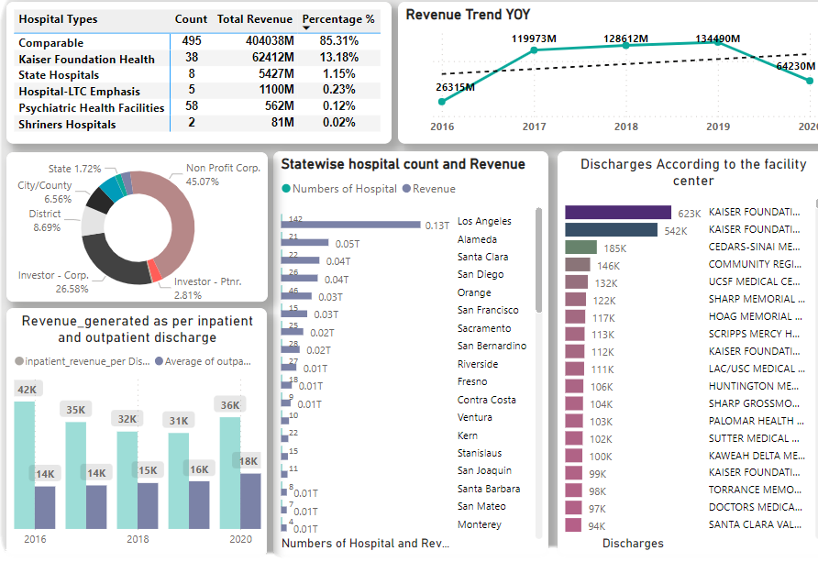
604
Hospital count
611
Number of CEO
474 bn
Net Revenue
growth
follow
patient Info
services
teams
about
474 bn
Net Revenue
Over the course of five years, our net revenue showcased an impressive upward trend, surging by a remarkable 160.73% from 2016 to 2020. This substantial increase is a testament to our continued growth and financial success, reflecting our strong market position and effective strategic management.

Slide 6
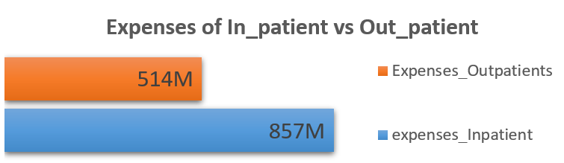
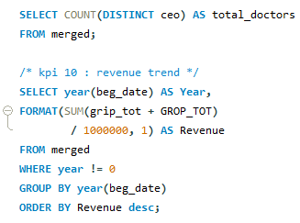
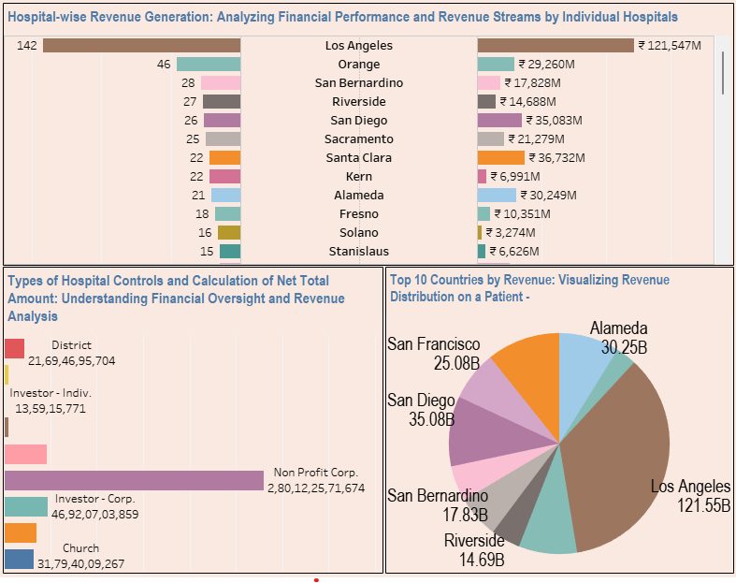
Excel played a vital role in our project, serving as the cornerstone for data maintenance and cleaning, allowing us to ensure data accuracy & reliability throughout the process.
Utilizing MySQL in our project, we effectively managed, cleansed data
Los Angeles accounted for 28.18% sum of Net Revenue.
growth
patient Info
follow
services
teams
about
﻿Non Profit Corporation accounted for 45% of Hospital Controls.
Revenue wise Hospital diverged the most when the Los Angeles, with Revenue were 121,547m.

Slide 7



Terminal Observation
Patient Collaborate
Seek input from patients, healthcare professionals, and administrators to shape improvement initiatives and ensure alignment with their needs.
growth
follow
patient Info
services
teams
about
Invest in Technology and Infrastructure
Implement health information exchange system to facilitate seamless sharing of patient information among healthcare providers.
Increase Revenue Generation
Establish partnerships with insurance providers and negotiate favorable contracts.

